Slide 1


Hashing
(And Strings)

Slide 2

CONTENTS
The why, what and how of Hashing.
Some mathematics behind hashing.
Problems (basics to advanced)
Hashing a Tree??
Randomizing your solutions
Tries

Slide 3
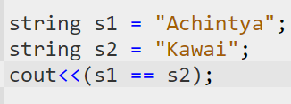

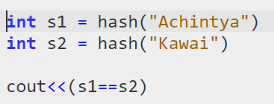
Why do we need a hash?

Slide 4
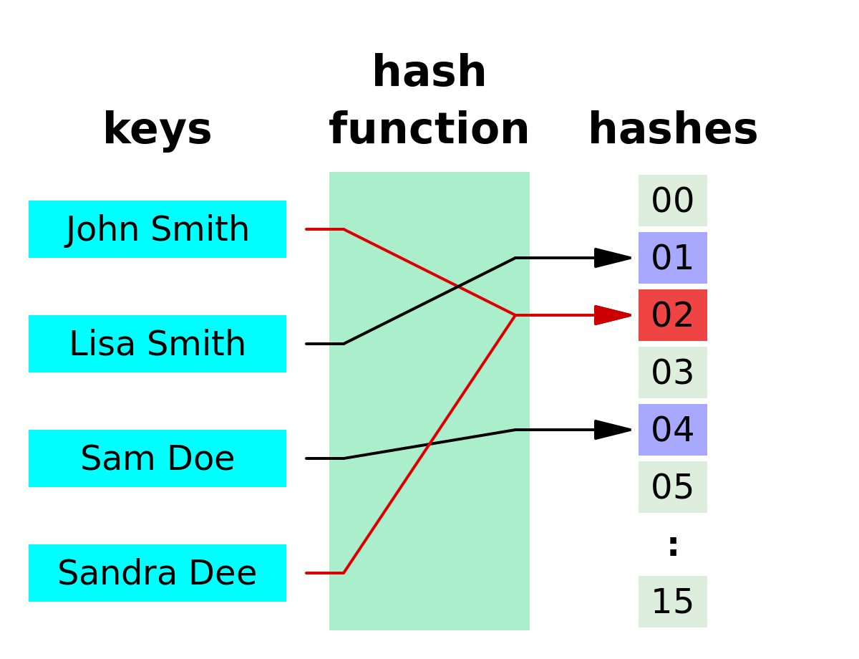
What is a hash?
Many one function
BoundedNess
Pigeon Hole Principal?
Collision

Slide 5

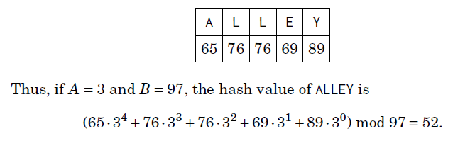
Rolling Hash

Slide 6
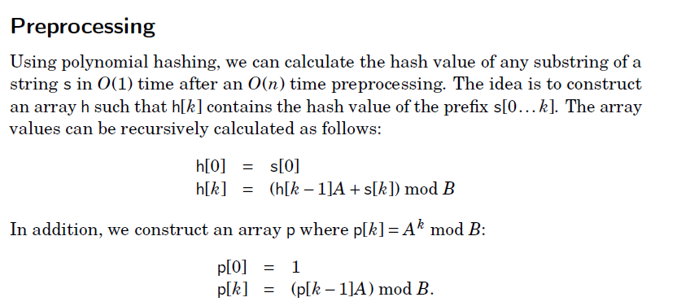
Computing a Hash

Slide 7
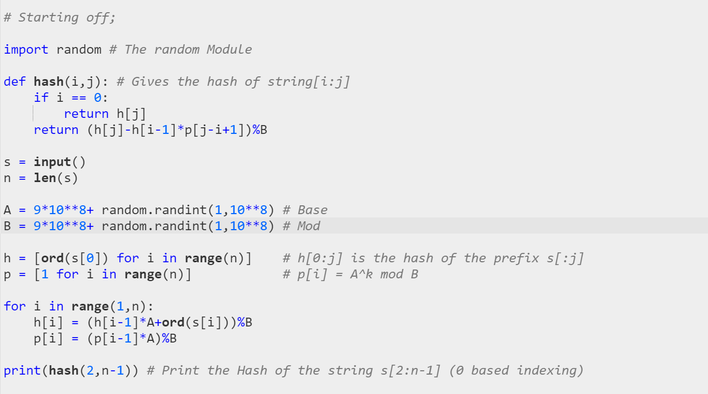
The Complete Code

Slide 8
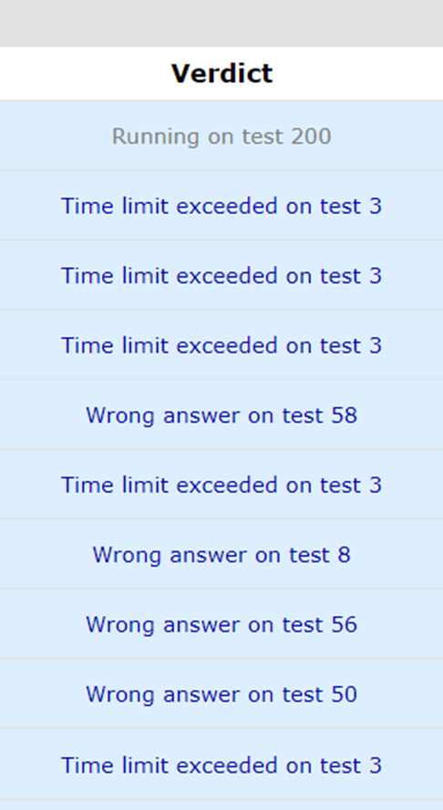
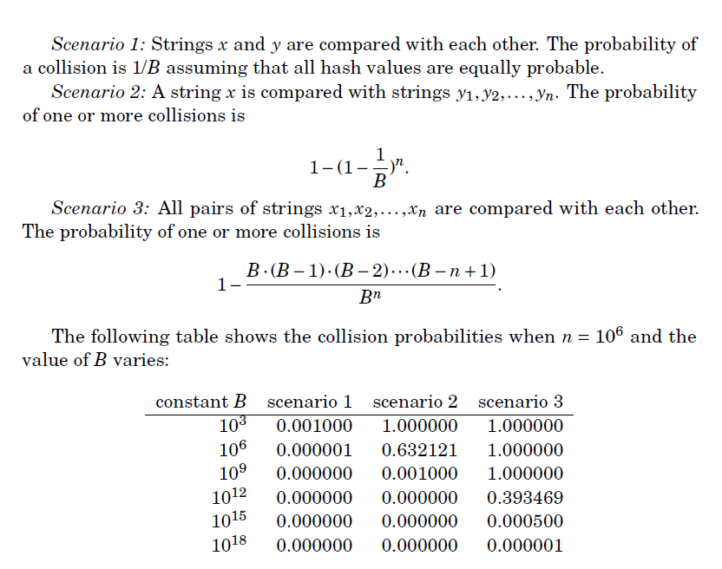
Collisions!

Slide 9
Ancient Rivalry
Shrey has a string s of length n (<2e5). He decided to remove two consecutive characters from the string but doesn’t inform Dev about it (as always). Dev now wonders how many different strings can be made after such an operation.
Sample:
‘aaabcc’ has four such distinct strings;
‘abcc’
‘aacc’
‘aaac’
‘aabc’

Slide 10
“Bhai sacchi, mai kuch nhi padha”
~ Every CSE guy ever
The End Sems are approaching and Achintya (after just lying that he hasn’t studied anything) sits to solve a problem.
The ‘period’ of a string is a prefix that can be used to generate the whole string by repeating the prefix. The last repetition may be partial. Help him find all periods of the given string S, (n<2e5)
Sample :
‘abcabca’ -> 3,6,7
Explanation:
The given string has 3 periods :’abc’ , ‘abcabc’, ’abcabca’

Slide 11
A String for a Rose
Gautam is trying to impress his crush, but all he has is a string S (n<2e5) (and not a rose). So, to impress her, he wants to find the longest string T, that satisfies the following conditions:
length of T < length of s
T is a palindrome
There exists two strings a and b (possibly empty) such that T = a+b where a and b are a prefix and suffix of the string respectively.
Sample:
‘acbba’ -> ‘abba’
‘xyzyz’ -> ‘zyz’

Slide 12
Palindrome Queries
After all that efforts of finding the perfect palindrome, his crush was barely impressed. But Gautam doesn’t give up yet. His crush now tests him by giving him another string S (n<2e5) and tells him to Q queries (q<2e5) of two types :
1 x c -> Change the ‘x’ th character to ‘c’.
2 l r -> Check if the substring S[L:R] is a palindrome.
Help him impress her :)

Slide 13
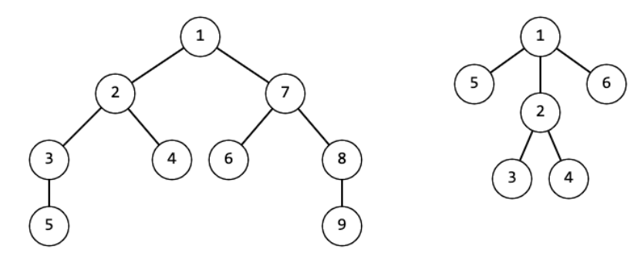
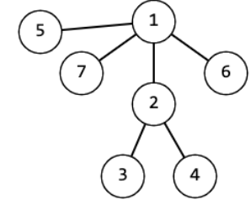
Trees …. Hmmmm…. Hashable?
Isko bhi nhi chorenge
Are strings the only hashable data structures? Try this question!
You are given a tree (nodes<2e5). Check if the tree is symmetrical.
Symmetrical Trees Unsymmetrical Tree

Slide 14
Don’t get hacked!
How many times have you been hacked in Div 3, Div 2 and Edu rounds?
Hackable Data Structures:
Unordered_set , Unordered_map in C++
Set and DIct in Python (aka everything )
Unless your hash function is purely random, you will always be hacked in contests with hacking rounds. The reason being that hash functions can always be given a certain type of input that makes it collide

Slide 15
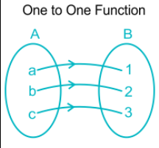
Randomizing Hash
Is the anything truly random?
Ever tried using rand() in C++ multiple times?
What is something that keeps changing instantly? (take some TIME to think)
Maybe we could apply a one-one function on the input and then hash it?

Slide 16
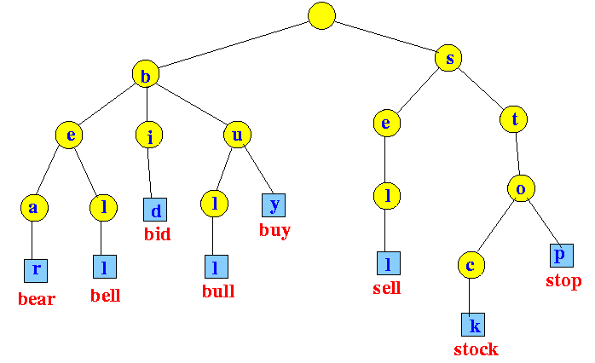
Tries

Slide 17
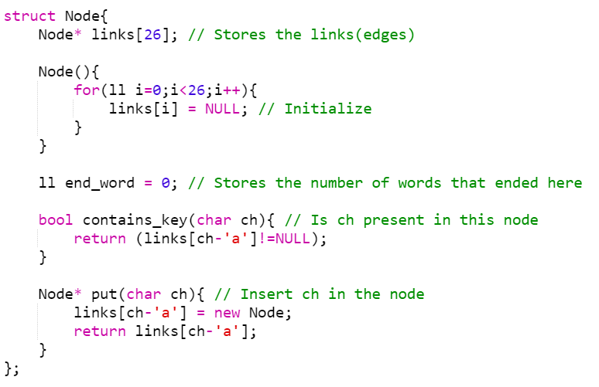
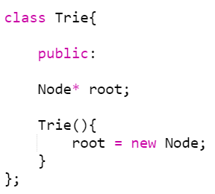
Code!?

Slide 18
Longest Common Prefix
You are given n strings s1,s2,..sn. FInd the longest common prefix of them.
Sample 1: ‘Ayush Kumar’ , ’Ayush savar’ , ‘Ayush Patidar’ -> ‘Ayush’
Sample 2: ‘Faiz’ , ‘Yash’ , ‘Tanmay’ -> ‘ ‘
Sample 3 : ‘Deepak’ , ‘Dhyey’, ‘Dev’ -> ‘D
Constraints:
0 <= sum(len(si)) <= 1e6

Slide 19
Shortest Unique Prefix
You are given n strings s1,s2,s3… sn. Find the shortest unique prefix for each of them.
Sample 1: ‘Shashwat’ , ‘Shobhit’ ,Shreyans’ , ‘Soumya’ -> ‘Sha’, ‘Sho’ , ‘Shr’ , ‘So’
Sample 2: ‘Arush’ , ‘Asutosh’ , ‘Atharva’ -> ‘Ar’ , ‘As’ , ‘At’
Constraints :
0 <= sum(len(si)) <= 1e6

Slide 20
Maximum Xor
You are given two array A and B. Pick one element from both array such that their xor is maximum.
Sample: A = [1,2,3], B = [1,2,4]
Output = 7
Constraints:
0 <= Ai,Bi <= 1e9
1 <= N <= 1e5

Slide 21
Guess?
Achintya has an array of n non-negative integers. He randomly picks two numbers one after the other (with replacement) from this array, say a and b. He then tells the value of:
a to Aryan
b to Abhijeet
a|b to both of them.
Aryan and Abhijeet don’t know about the array either. They take turns guessing if a<b or a>b or a==b. In their turn, a player can:
Say “I don’t know”, and pass the turn to the other player
Say “I know”, followed by “a<b” or “a>b” or “a==b”. Then the game ends.
Aryan and Abhijeet can hear what each other say and use this information to deduce the answer. Also they are honest enough (In the context of this problem) to say “I know” only when they truly do. You need to find the expected value of the number of turns taken by the players in the game modulo 998244353.

Slide 22
Solution
Consider the binary representation of a|b from highest to lowest. If a bit is 0, we for sure know that the corresponding bit of a and b is also zero. Now let’s consider the set bits of a|b
If the highest bit of a is 0, then we sure know a<b. Hence the game ends. Else Abhijeet knows that first bit of a is 1 (else aryan would have ended the game). Accordingly if first bit of Abhijeet is set, only then will the game proceed to next set bit of a|b. Else it concludes with Abhijeet saying a>b.
This cycle continues and ultimately we could conclude on the following observations, considering only set bits in a|b and enumerating them from highest to lowest.
If a<b , and the i’th bit in a is 0, the answer is “ i+1-(i%2==1) ”
If a == b, then the answer is “k+1” where k is the number of set bits in a|b
If a>b , and the i’th bit in b is 0, the answer is “ i+(i%2 == 1) ”

Slide 23

Thank You :)

